Slide 1

Stock Portfolio Analysis with Time Series Forecasting
By:
Mani Teja Gunda

Slide 2
Steps Involved in this Project
Fetched the Data of 10 CPG Manufacturing Companies from Yahoo Finance
Cleaning and Preprocessing the Data
Calculation of Daily returns and Sharpe Ratio
Stationarity Check for the Data using ADF
Seasonal Decomposition
ACF and PACF plots
Timeseries Forecasting using ARIMA model
Timeseries Forecasting using AR model
Timeseries Forecasting using MA model
Forecasting Future Stock values for the next 15 steps using the best-fit models for each stock based on our analysis

Slide 3
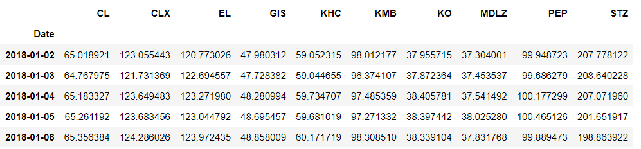
Companies we used in our portfolio
We are taking a portfolio that consists of 10 CPG manufacturing companies
KO - Coca-Cola
PEP - PepsiCo
CL - Colgate-Palmolive
KHC - The Kraft Heinz Company
MDLZ - Mondelez International
GIS - General Mills
EL - Estée Lauder
KMB - Kimberly-Clark
STZ - Constellation Brands
CLX - The Clorox Company

Slide 4
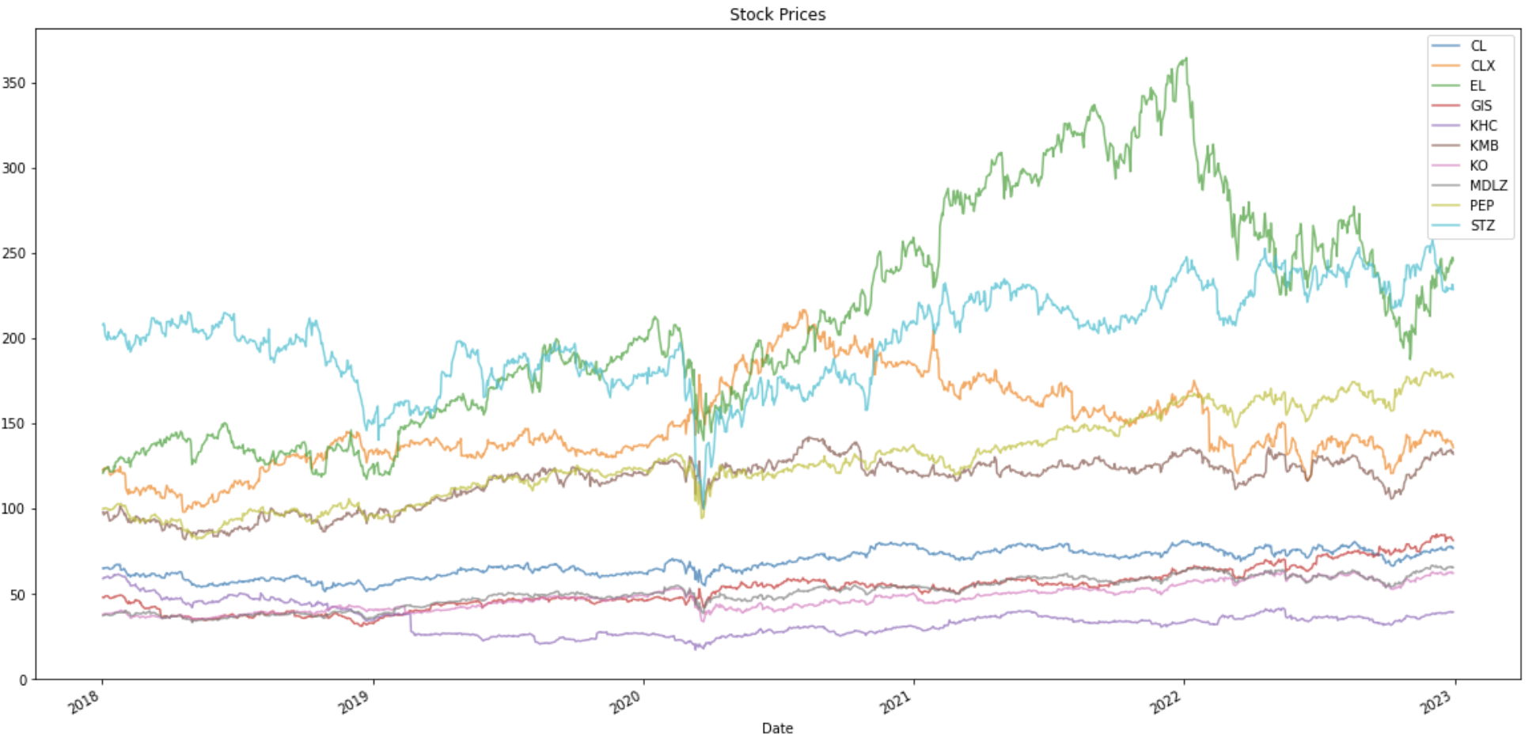
Visualizing the Data
We can observe that there was a slight decrease in prices of all the stocks except for CLX - Clorox during the first quarter of 2020

Slide 5
Preprocessing
Removed Null Values
Handled Outliers in each and every stock

Slide 6
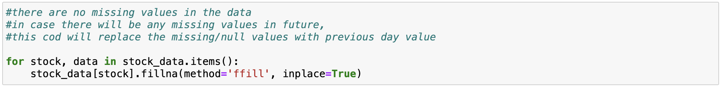
Removing Null Values
For the stocks and the time frame we selected, there are no null values in the data
The following code is implemented to treat the null values in case we change the stocks or time frame
This code will replace the null values with previous day value

Slide 7
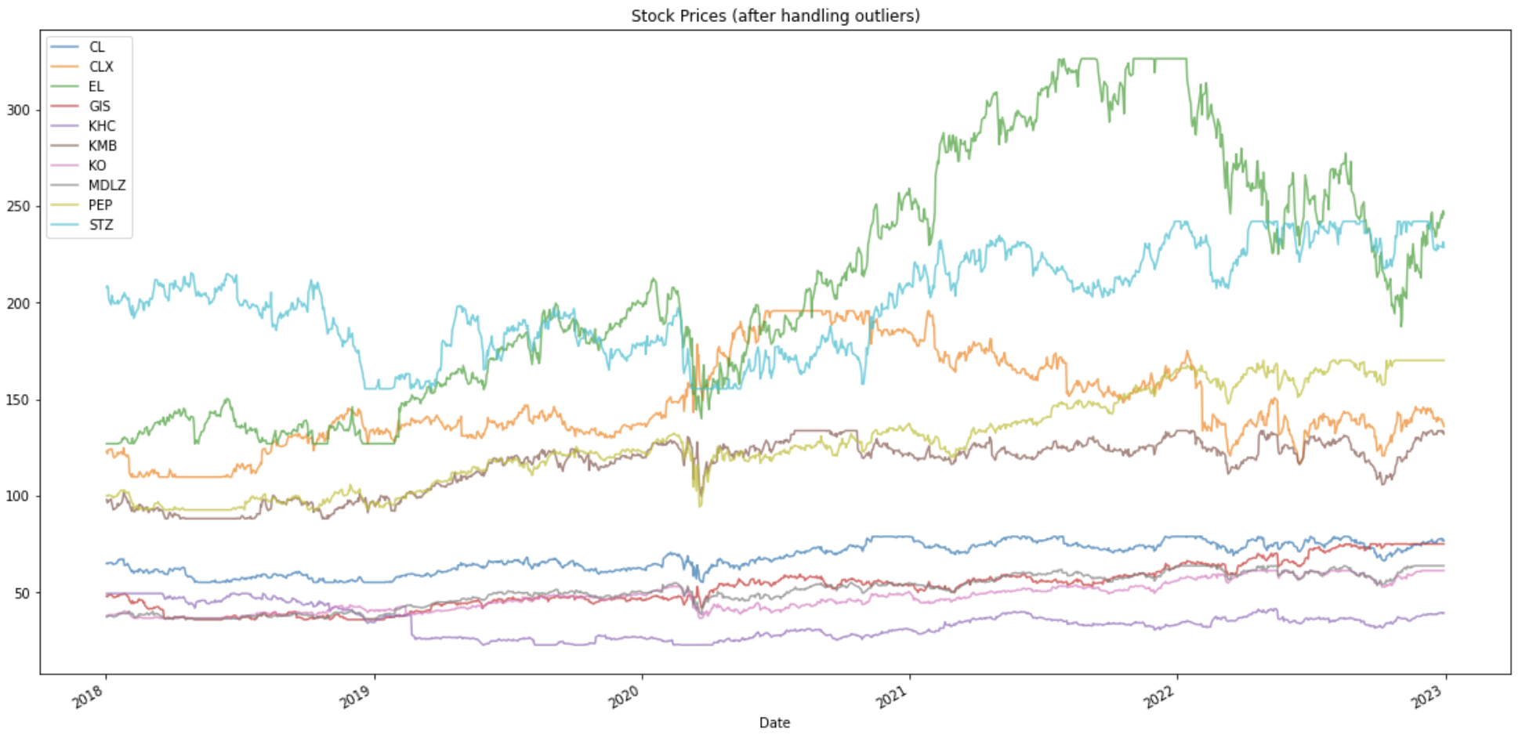
Handling Outliers
There might be extremely high or extremely low values on some dates in the data
These values will skew our results, so we are clipping the 5th percentile and 95th percentile of the data of each stock respectively

Slide 8
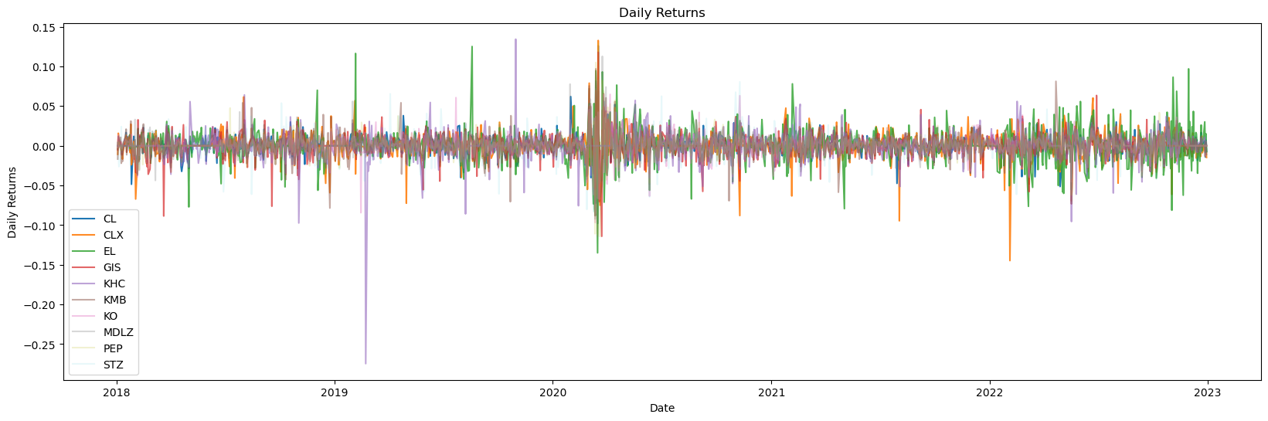
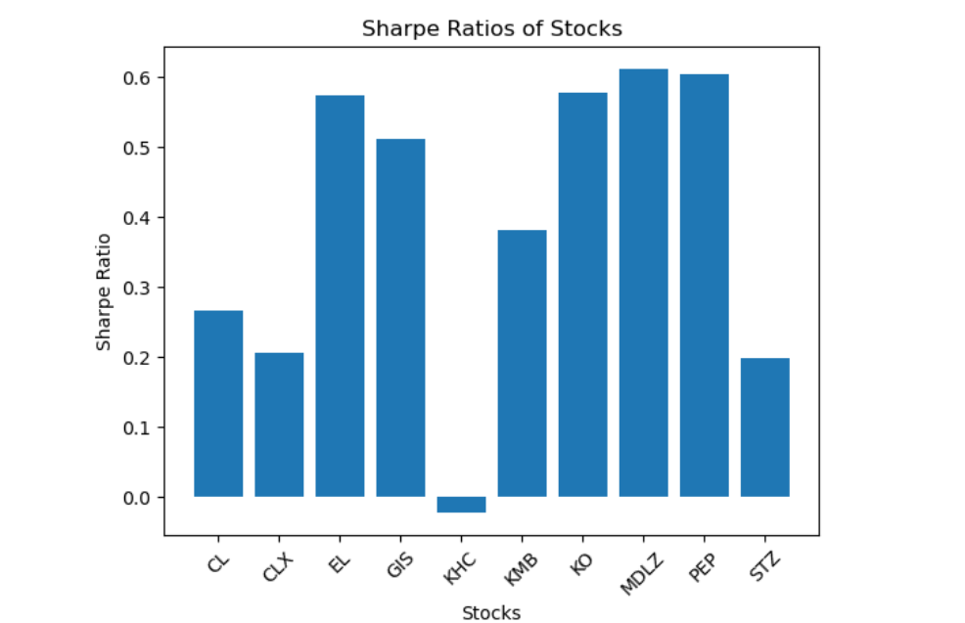
Daily Returns and Sharpe Ratio
Only the KHC has negative sharpe ratio and it might not offer better returns. EL, KO, MDLZ and PEP offer better risk adjustment when compared to other stocks.

Slide 9
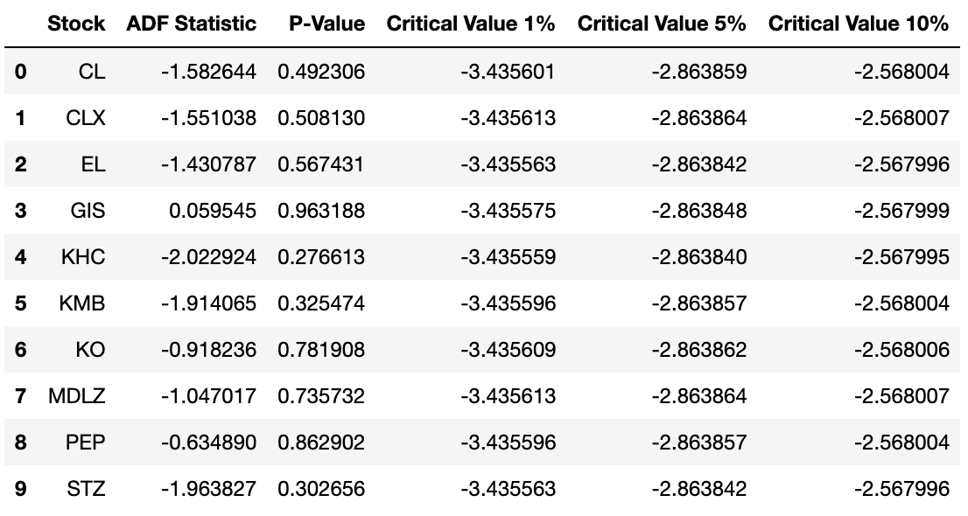
Stationarity
For the stocks KO, PEP, and GIS, the ADF statistic is less than the critical values at all confidence levels (1%, 5%, and 10%). This suggests that these stocks' time series data is likely stationary.
For other stocks like KHC, MDLZ, and STZ, the ADF statistic is close to the critical values, and the p-values are relatively higher. This indicates that there's weaker evidence to conclude stationarity for these stocks.
EL, CLX, and KMB also show ADF statistics close to the critical values, with moderate p-values, suggesting a weaker case for stationarity.
CL exhibits an ADF statistic above the critical values, with a high p-value, indicating that its time series data is likely non-stationary

Slide 10
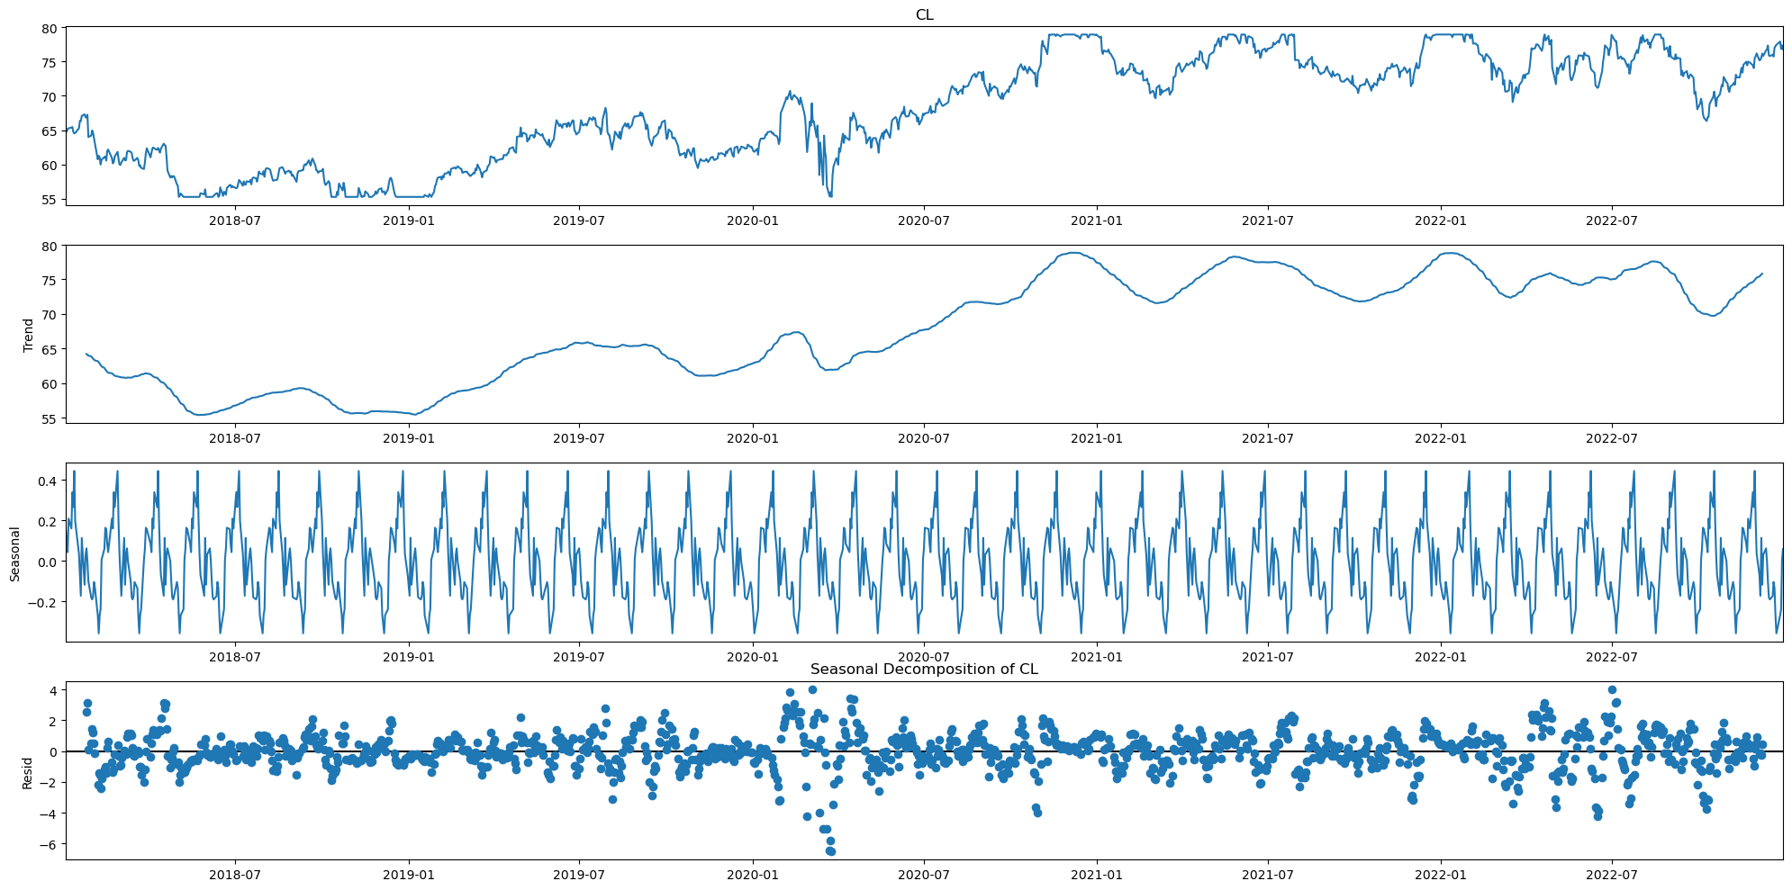
Seasonal Decomposition
This is the seasonal decomposition plot for CL and we can make the following interpretation from the plot.
The trend component of the graph shows that the closing price has been increasing over time, while the seasonal component shows that the closing price has been decreasing over time.
The residual component of the graph shows that the closing price has been fluctuating around the trend line.

Slide 11
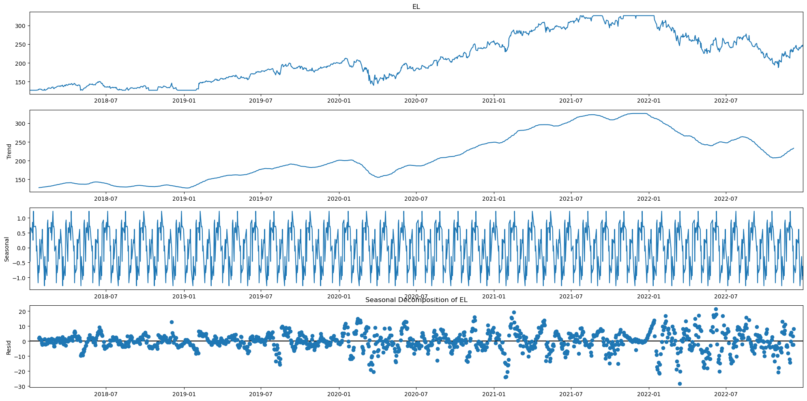
Seasonal Decomposition
This is the seasonal decomposition plot for EL and we can make the following interpretation from the plot.
The stock value of the company has been fluctuating over time.
The trend component of the graph shows that the stock value has been increasing in a linear trend until 2022 and it has started declining post that.
The residual graph shows that the stock value has been fluctuating around the trend line

Slide 12
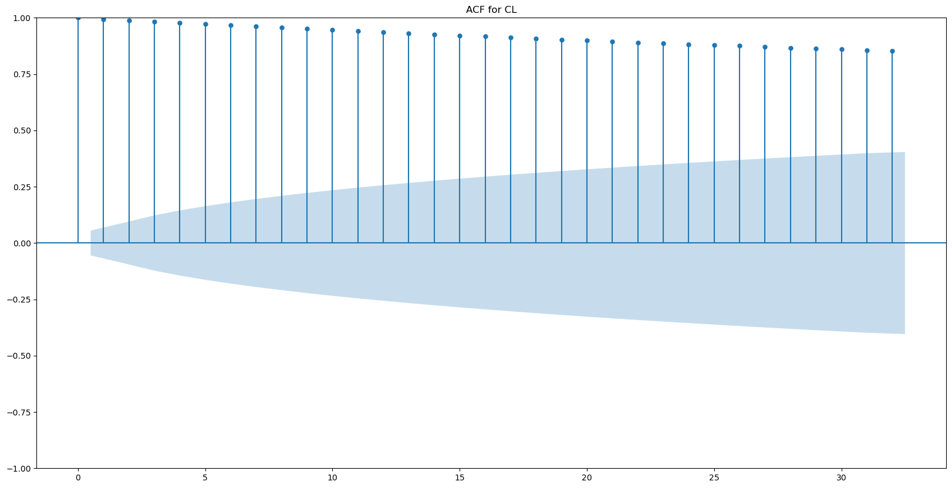
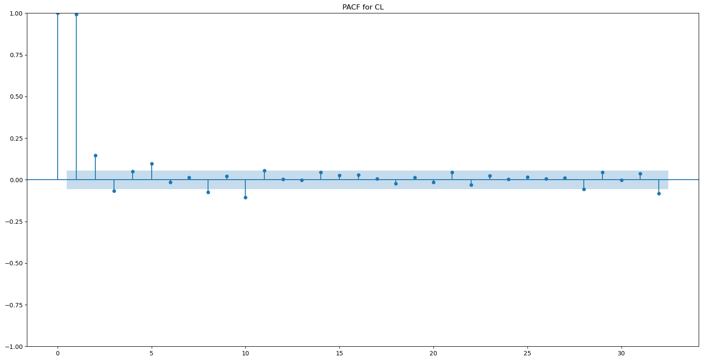
ACF AND PACF
We harnessed the power of ACF (Autocorrelation Function) and PACF (Partial Autocorrelation Function) to determine the most suitable time series forecasting model for each of the 10 CPG manufacturing companies we analyzed.
By carefully examining these plots, we identified the order of autoregressive (AR) and moving average (MA) components, which guided our choice of forecasting models.
Given the unique behaviors of each stock, we applied a tailored approach, utilizing AR, MA, and ARIMA models to ensure accurate predictions that reflect the distinct characteristics of the individual companies' time series data

Slide 13
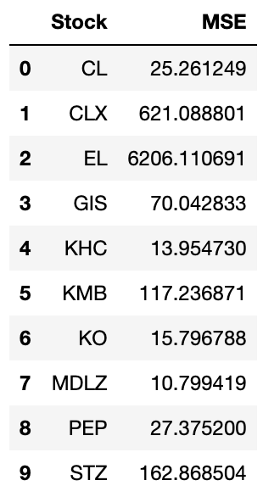
Time Series Forecasting using ARIMA model
The Mean Squared Error (MSE) values derived from the ARIMA models offer valuable insights into the precision of these models in predicting stock prices. Lower MSE values generally signify more accurate predictions, indicating that the models' forecasts closely match the actual values.
For KHC, PEP, MDLZ, KO and CL, MSE is lowest, suggesting accurate predictions.
KMB, STZ and GIS have moderate MSE, indicating reasonable performance.
CLX, and EL show higher MSE, implying less precise predictions

Slide 14
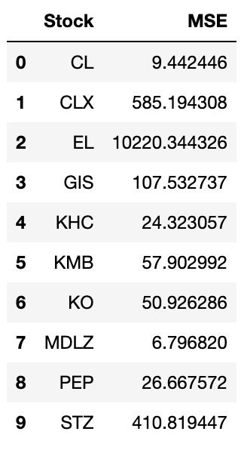
Time Series Forecasting using AR model
MLDZ has lowest MSE value indicating better model performance.
CL also has lower MSE which is also lower than ARIMA.
CLX, EL, and STZ have higher MSE values indicating poor performance.
GIS, KHC, KMB, KO and PEP has moderate MSE values indicating moderate fit for this model

Slide 15
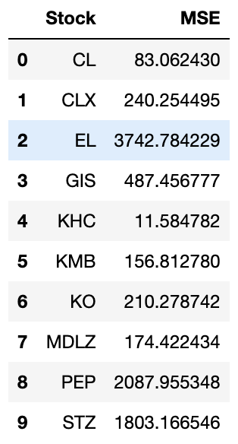
Time Series Forecasting using MA model
KHC has relatively lower MSE value indicating better model performance.
While MDLZ, CLX, KMB, GIS and KO has moderate MSE values, some of the values are higher than the respective MSE values from ARIMA and AR models.
EL, PEP, and STZ have very high MSE values indicating poor performance and fit.
Although CL has lower MSE value, it is still higher than the MSE values of ARIMA and AR.

Slide 16
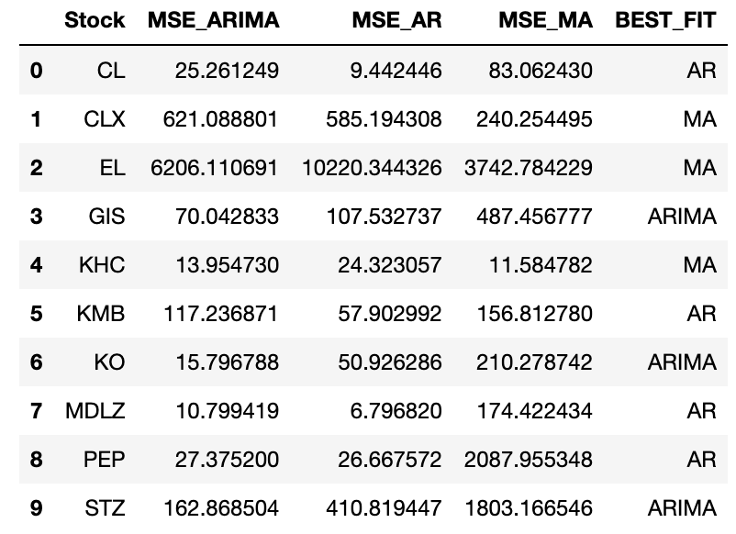
Comparing Three Models
Consider using AR model for CL, KMB, MDLZ and PEP stocks
Consider using ARIMA model for GIS, KO and STZ. The ARIMA model might not be a reasonable choice for these stocks and is worth exploring the alternatives.
Consider using MA model for CLX, EL, and KHC stocks.

Slide 17
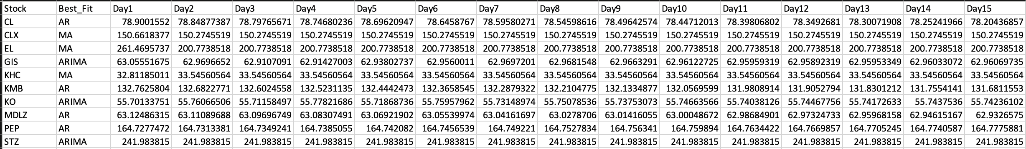
Forecasting Future Stock Values
In this step , we selected the most suitable model (either AR, MA, or ARIMA) for each stock based on our prior analysis. Subsequently, we showcase forecasted values for specific stocks for the upcoming 15 steps. Our objective is to provide precise predictions that can contribute to well-informed investment decisions by employing these best-fit models.

Slide 18
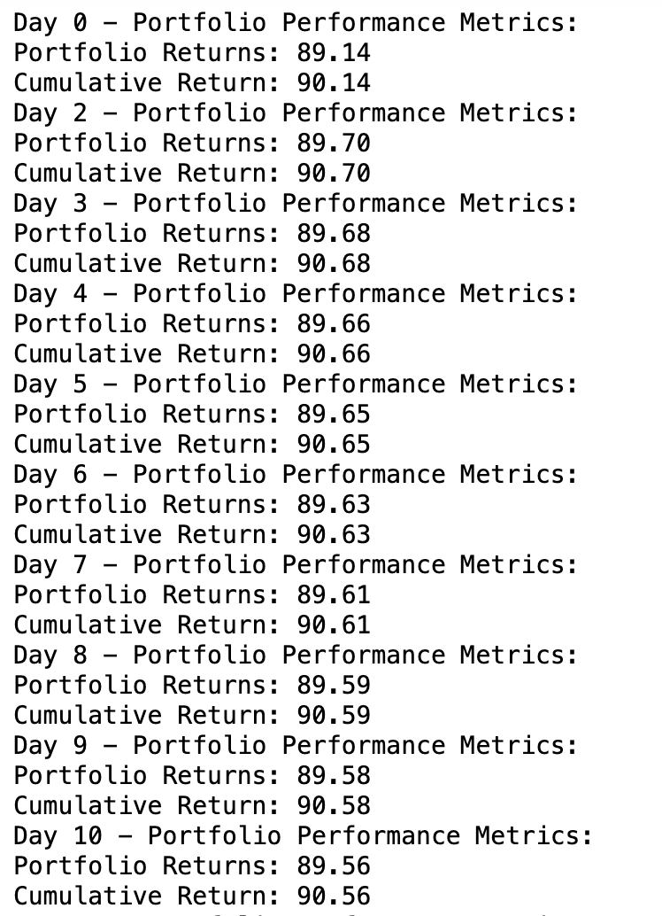
Portfolio Performance

Slide 19

Conclusion
Explored time series analysis for stock price prediction of 10 CPG manufacturing companies.
Applied MA, ARIMA, and AR models to capture historical patterns and future trends.
Evaluated model performance using Mean Squared Error (MSE).
Identified stocks with higher prediction accuracy.
Successfully predicted stock values for the next 15 days using the chosen models.

Slide 20

Future Scope
Advanced Forecasting Models
Implement advanced time series forecasting models like SARIMA, LSTM, or Prophet for improved accuracy.
External Factors
Include external factors (e.g., economic indicators) for a more comprehensive analysis.
Portfolio Management
Develop a portfolio optimization strategy for better risk management and higher returns.
Real-time Monitoring using Dashboard
Create a real-time monitoring dashboard for continuous tracking and visualization of stock price predictions.

Slide 21

Thank you

